Slide 1
GitHub Link
https://github.com/Raahguu/Blockchain-CTF-Basics-Workshop-Scripts

Slide 2
Blockchain CTF Basics
Joshua Finlayson

Slide 3
Blockchain Basics

Slide 4
Transactions
A Blockchain is a globally shared, transactional database
Everyone can Read wherever, whenever
To Write you need to make a Transaction
A Transaction means that either all the changes are made at once, or none are
Only one Transaction can occur at a time
Transactions are always signed

Slide 5
Blocks
In a peer-to-peer network the idea of 'first' is hard to define
So based on blockchain specific algorithms and the miners/stakers, transactions are bundled into 'blocks'
These blocks contain the hash of the previous block, then are added to the network
Blocks can be reverted occasionally, but this results in every block after it also needing to be reversed
The inclusion of the hashes forms the 'chain' in Blockchain

Slide 6
Block Contents
Component | Purpose
Header | Stores Metadata
Previous Block Hash | Links to Previous Block
Timestamp | When the block was added to the network
Transactions | All the transactions within the block
Transaction's Hash | Hash of all the transactions
Nonce | The nonce used as Proof-of-Work
Block Hash | Hash of the Block
* As Ethereum no longer uses Proof-of-Work, the 'nonce' is a legacy field

Slide 7
Miners vs Stakers
Blockchains work based of Proof-of-Work (Miners), or Proof-of-Stake (Stakers)
Miners race to find a nonce for each block that matches the difficulty level (so the hash has a certain number of 0s at the start), then broadcast it first
Stakers/Validators 'stake' some cryptocurrency of theirs, and are randomly selected to propose/confirm new blocks
If Stakers/Validators lie, they lose part of their stake

Slide 8
Ethereum Virtual Machine (EVM)

Slide 9
Ether and Wei
As float math is hard, blockchains avoid it by representing their token as an integer that needs to be shifted
Values are stored as uint256s, and in Wei
1 Ether = 10¹⁸ Wei

Slide 10
Accounts
Two kinds of accounts in Ethereum
Externally Owned Accounts (EOAs) - Users
Has a public/private key pair
Has an Ether balance
Contracts - Code
Stores Code
A Ether Balance
Has Storage

Slide 11
Transactions
Transactions can carry an arbitrary payload in addition to Eth
Therefore, the EVM can take the payload of a Transaction and use it to call functions on contracts
Or use it to carry code to create contracts

Slide 12
Gas
When a Transaction is created, the creator must pay for 'gas'
This 'gas' compensates the Stakers who validate the transaction, and ensures blockchains are not flooded with transactions
The more complex a transaction/longer it takes/more storage it takes, the more gas is needed
If the required gas is higher than the supplied gas the transaction is cancelled, no gas refund
Blocks have a maximum amount of gas
Any extra gas is refunded

Slide 13
Break

Slide 14
Smart Contracts

Slide 15
What are Smart Contracts?
A state machine deployed to the blockchain
It is some code permanently on the blockchain that can be interacted with through its 160-bit address
Anyone can execute transactions with it where they call functions defined within it
An address that function names and values can be sent to that does stuff

Slide 16
Solidity
The most popular language for implementing EVM smart contracts
The language we will be covering in this workshop, and the one most common in CTFs
Gets compiled into EVM bytecode
Is JavaScript-esque

Slide 17
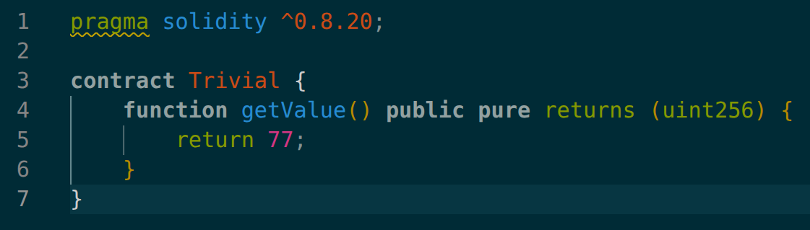
Trivial
Breakdown:
pragma solidity ^0.8.20; <- Specifies the version to compile for
contract Trivial <- Declares the name of the contract
function getValue() <- Declares a function called 'getValue' with no parameters
public <- Function called be invoked by an external transaction
pure <- Function does not have side effects, or access internal memory
returns (uint256) <- Function returns a 256-bit unsinged integer
return 77 <- Function returns the value '77'

Slide 18
view and pure
These are two special function 'modifiers' that make calling the function not need Gas
view is for when a function does not change anything about the blockchain
pure is for when a function is a view and it does not access the storage/contract-level variables

Slide 19
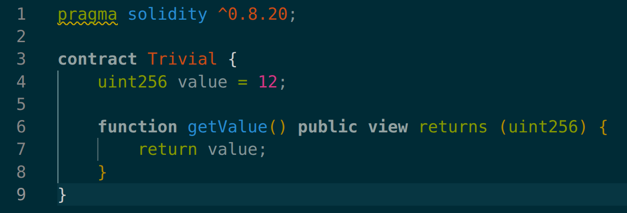
Trivial with State
uint256 value = 12 <- Defines contract-level variable of type 'uint256' into storage that is persistent between transactions, that default to '12'
view <- The function access storage and so is not pure

Slide 20
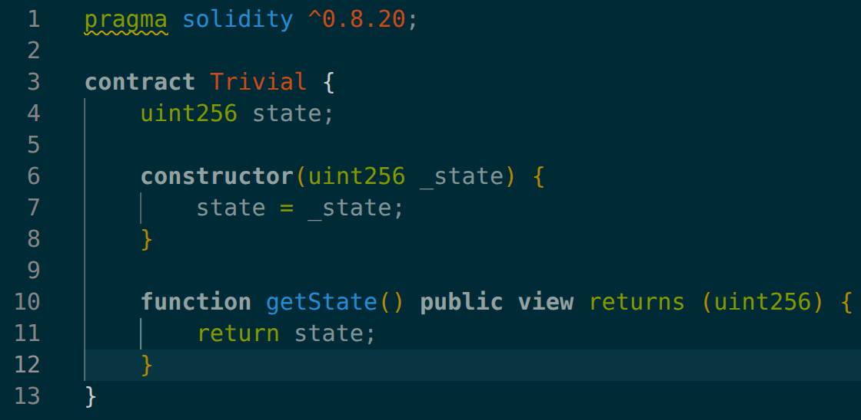
Trivial with Constructed State
constructor <- defines the '__init__' function for the contract
uint256 _state <- 1 argument of type uint256 for the constructor

Slide 21
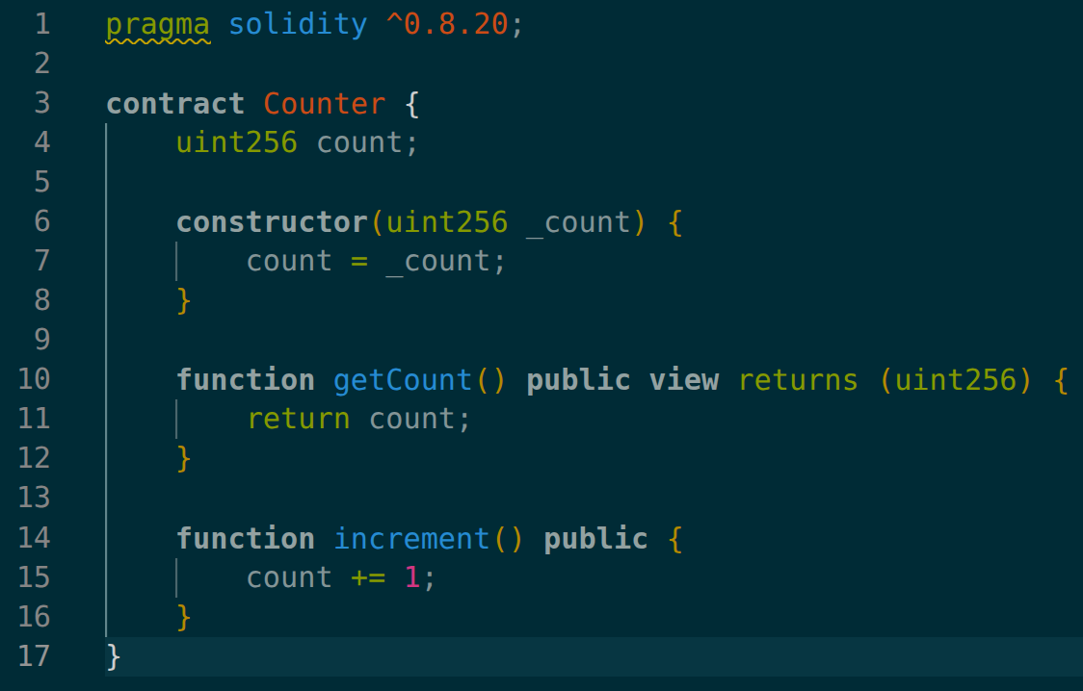
Counter
increment is not a view because it changes values in storage (count)
Because it is not view, it takes gas

Slide 22
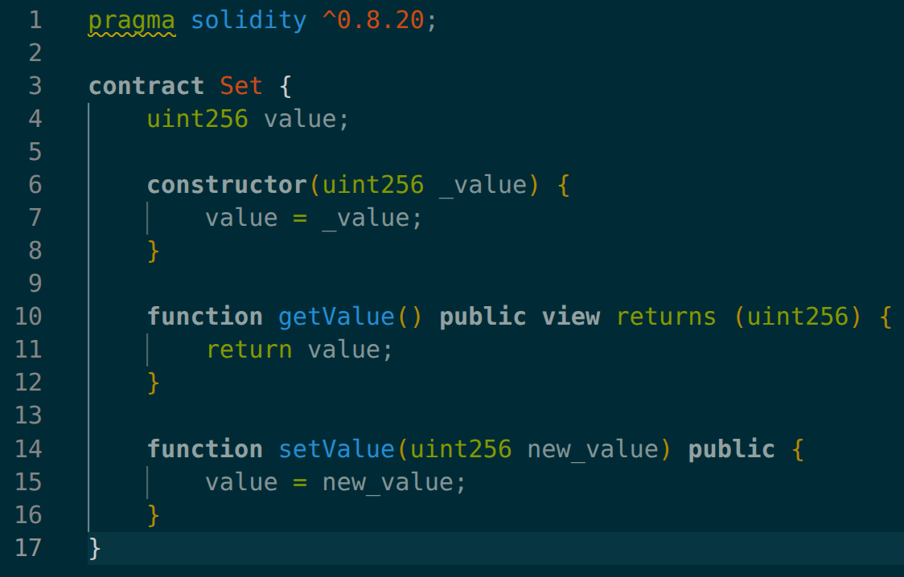
Set
setValue is called with an argument of type uint256

Slide 23
Foundry

Slide 24
Install
Do NOT run 'sudo apt install foundry'. That is NOT the tool.
Go to https://www.getfoundry.sh/ and run the install command
Reload your path (new terminal, or reload source)
Then run the command 'foundryup'

Slide 25
RPC
Remote Procedure Call (RPC) is a protocol to communicate with a server over various mediums.
The one we will use will be 'HTTP'
To interact with the blockchain, you need to connect to it somehow
RPC is one of the many ways to connect with nodes hosting a blockchain
The private redroom blockchain RPC URL is http://blockchain.redroomctf.au

Slide 26
cast call
With foundry you get a tool called 'cast' so you can interact with the blockchain
There are two main ways to interact with it, 'call' (for view/pure) and 'send' for transactions
To send a 'call' request, the command is:
cast call <CONTRACT_ADDR> "<FUNC>()" --rpc-url <URL>

Slide 27
cast send
send is for Transactions that will be bundled into blocks
As all sends need gas and to be signed, you need a private key
Syntax is similar to call:
cast send <ADDR> "<FUNC>()" --rpc-url <URL> --private-key <PK>
This means every send costs money

Slide 28
cast send with arguments
For functions with arguments, send can also send the arguments
For this, in the brackets the type is included, then the values after the signature
The syntax is:
cast send <ADDR> "<FUNC>(<TYPE>,<TYPE>)" <Arg1> <Arg2> --rpc-url <URL> --private-key<PK>

Slide 29
Break

Slide 30
cast balance
Foundry lets one see the balance of any account, whether it be an EOA, or a contract
The balance is displayed in Wei
The syntax is:
cast balance <ADDR> --rpc-url <URL>

Slide 31
Contracts viewing account's balance
Just as there is the 'uint256' type, there is also the 'address' type which stores an accounts address
The address of a contract can be programmatically by converting 'this' into an address so: 'address(this)'
The address type has 6 attributes, one is 'balance' to get that address's balance in Wei
So a contract can see its own balance with 'address(this).balance'

Slide 32
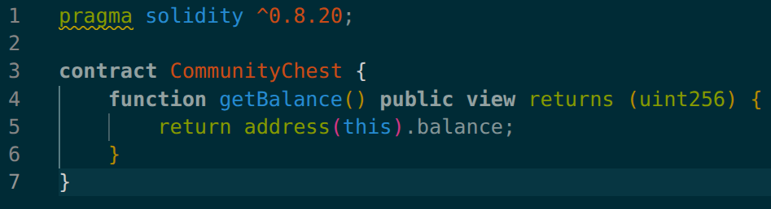
Community Chest

Slide 33
payable
To give money to a contract, functions can be given the modifier 'payable'
This means that the function accepts payment from whoever called it at whatever amount the caller wants

Slide 34
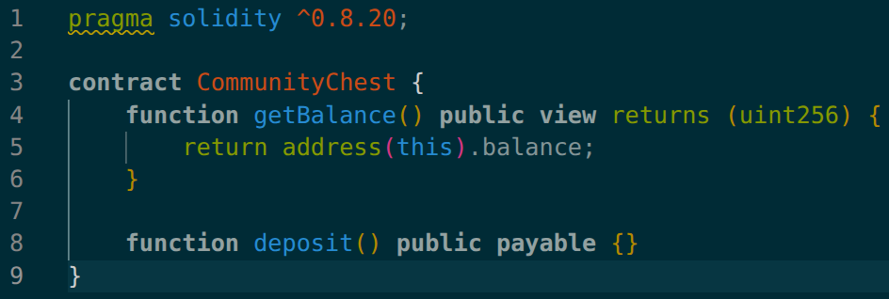
Community Chest v2

Slide 35
cast send with ether
To send a payable function ether, any send can just add '--value'
Afterwards, the amount of Wei can be specified, or the amount of ether followed by the word 'ether'
Syntax is:
cast send <ADDR> --value <Amount>[?ether] "<Func>(<Args>)" <Args> --rpc-url <URL> --private-key <PK>
It can also be sent to another account by specifying their public key as the address, without sending data

Slide 36
require
There is a function called 'require' which when passed a false bool, causes the transaction to fail
require has three overloads:
require(bool) ​<- revert with no error message
require(bool, string) ​<- revert with the string as the error message
require(bool, error) <- revert with the custom error

Slide 37
msg.value
A contract can access data about the message that was sent to it using 'msg'
One of these attributes is 'msg.value', which stores the amount of Wei that the message has sent to the contract

Slide 38
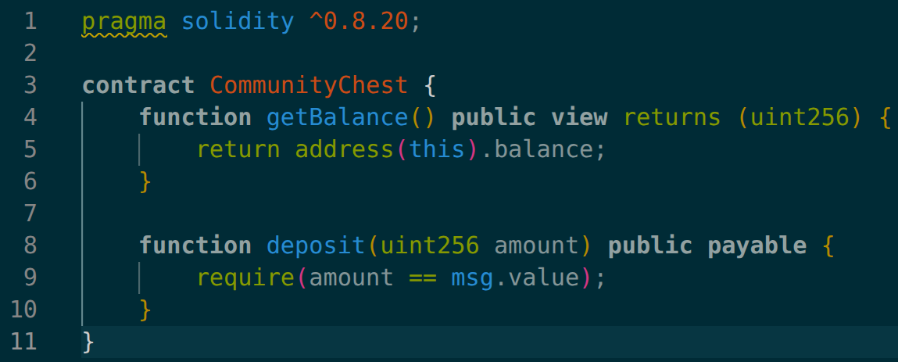
Community Chest v3

Slide 39
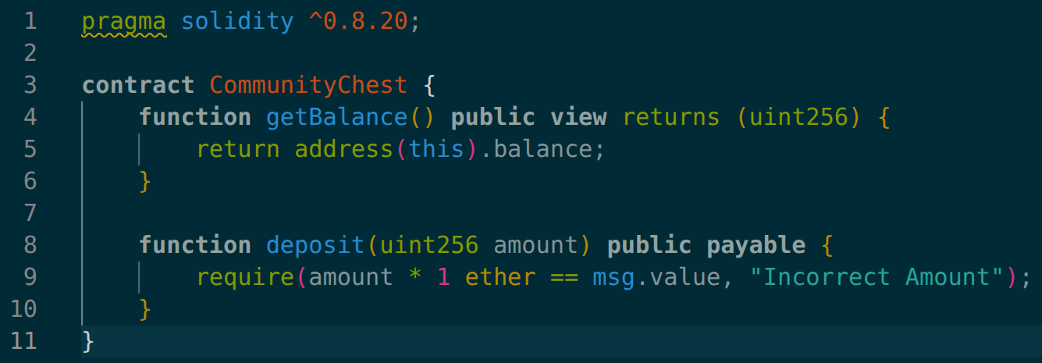
Community Chest v4

Slide 40
Deploying Locally

Slide 41
anvil
Foundry provides a tool to host your own small-scale blockchain network called anvil
You run it by just running 'anvil'
If you want to specify the port you can with '-p', the default is port 8545

Slide 42
-a --balance -m
By default, anvil creates 10 funded accounts the amount can be changed with '-a' to be any number
By default, each funded account gets 10 000 ETH, this can be set with '--balance'
By default, all the public and private keys are generated with the same seed phrase/mnemonic, this can be custom set with '-m'

Slide 43
forge create
It is useless to have an empty blockchain network, to deploy contracts to the network, then 'forge create' command can be used
The syntax is:
forge create <FilePath>:<ContractName> --rpc-url <URL> --private-key <PK> --broadcast
If there are constructor arguments they can be specified by placing the '--contructor-args' flag at the end, then listing the args

Slide 44
Default RPC
If the RPC for any foundry command is not specified, the command defaults to 'http://localhost:8545'
This means, if default anvil is running on a machine, any queries to that network do not need to specify the RPC

Slide 45
Break

Slide 46
msg.sender
As with 'msg.value' earlier which stored the amount of Wei the message sent to the contract contained, there is also 'msg.sender'
'msg.sender' stores the public key/address of the account that sent the message to the current contract as an 'address' type
If an EOA can send a message to a contract, which then sends a message to another contract, that second contract would have the 'msg.sender' value be the address of the first contract
To get the address of the original transaction sender 'tx.sender' is used

Slide 47
Sending Money
A contract can send money to an address using the 'call' method of the 'address' type
Just like with 'cast send', 'call' can send data with the amount and even call functions (this is not recommended)
The syntax is:
<address>.call{value: <Amount>}("");
The 'call' will either return 'true' or 'false' depending on if the transaction succeeded, and the returned data (in this case empty)

Slide 48
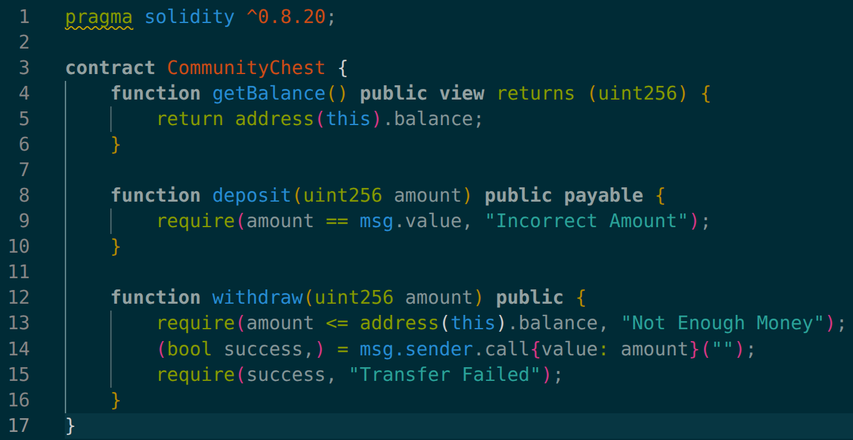
Community Chest v5

Slide 49
event and emit
Ethereum comes with a way to log activities, and events are a way for smart contracts to do that
Events with defined as a name and a number of parameters which are what will be logged
This is not useful for smart contracts themselves, but for the decentralised Apps (DApps) that are built around them
The syntax is:
event <Name>(<Type> <Param_Name>, <Type> <Param_Name>, …);
There is no limit on arguments
Events are logged using the 'emit' keyword
emit <Name>(<Arg_1>, <Arg_2>, …);
view or pure functions cannot emit events

Slide 50
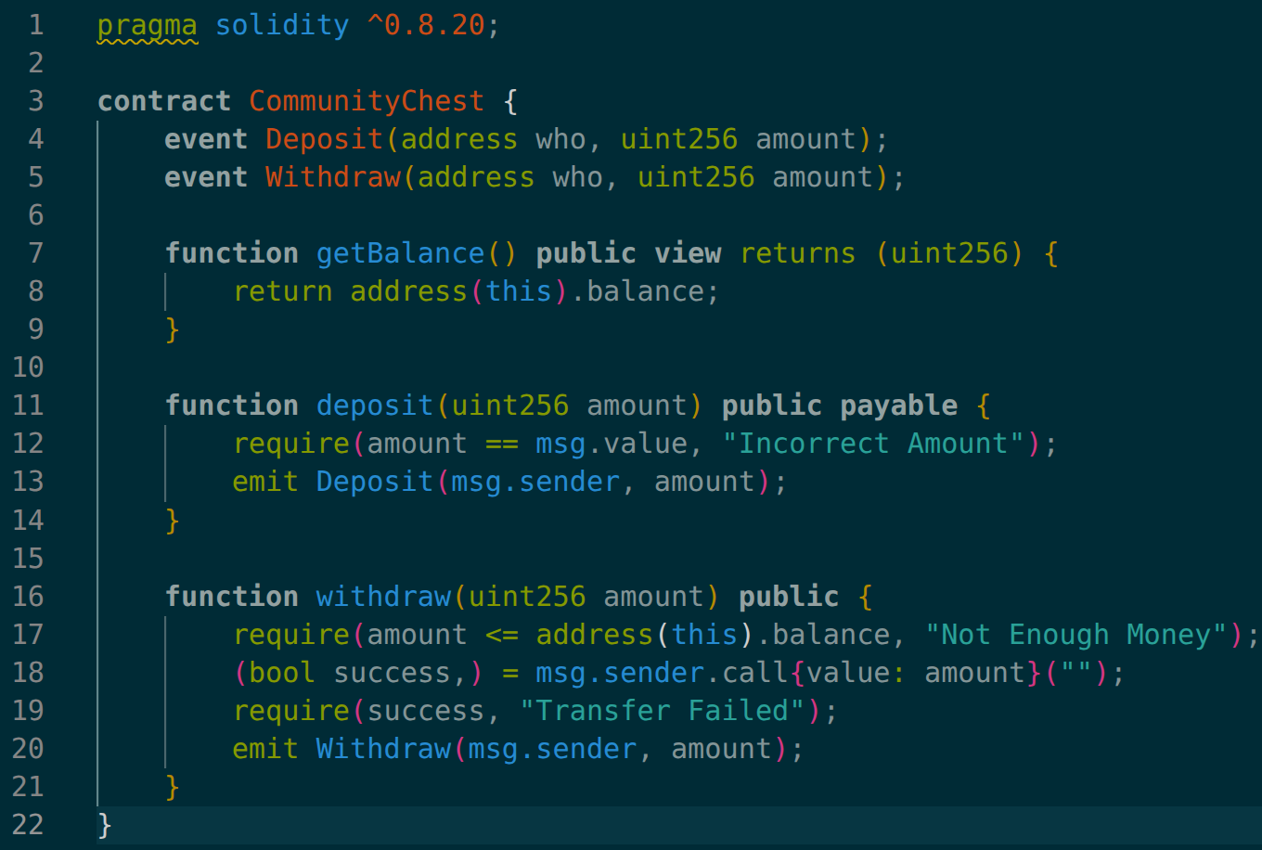
Community Chest v6

Slide 51
indexed event
Just as with views in SQL, the events can have 'indexed' parameters that are used to quickly sort through them
This is used by specifying the word 'indexed' after the type of the parameter
There can only be a max of 3 indexed parameters per event
Each indexed parameter must be max 32 bytes, so any data longer than that, or that is of variable size, is hashed

Slide 52
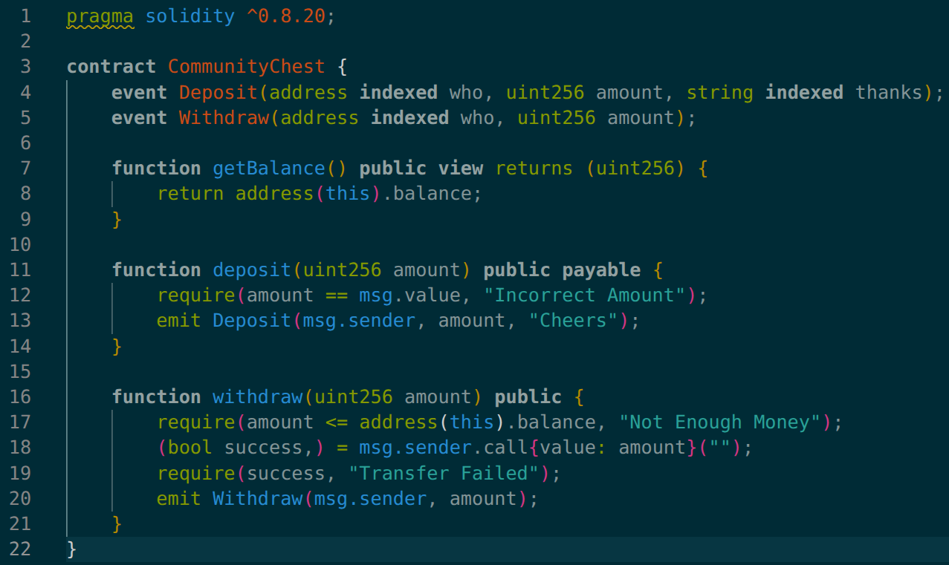
Community Chest v7

Slide 53
receive and fallback
Contracts can receive money from 'payable' functions, but when they pay accounts, they just send money
If a contract needs to query another, to be paid, they need some way of being paid the same as EOAs
There are two functions for this 'receive' and 'fallback'

Slide 54
receive
A contract can define a receive function, which is the function that will be called when a transaction with ether but no data is sent
receive must be payable, and it must be external
external means that while other accounts can call the function, the contract can't call it itself unlike public which anyone can call

Slide 55
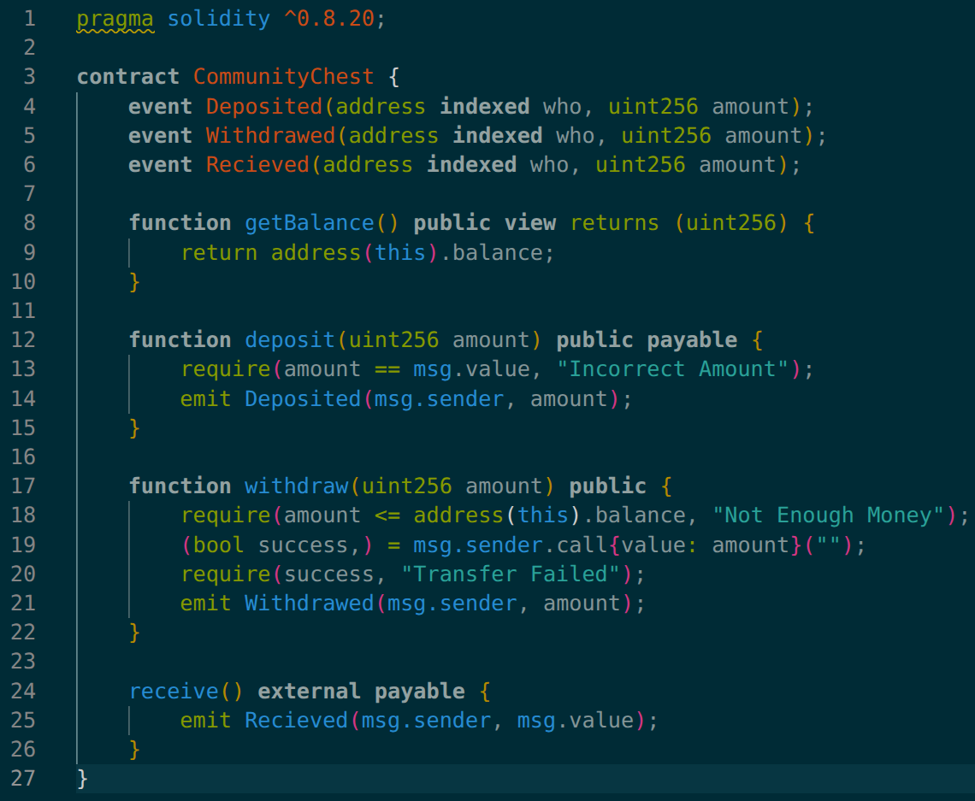
Community Chest v8

Slide 56
fallback
A contract can define a fallback function which is a function that is called when the data sent with a transaction does not match any other function
This includes if the data is empty
fallback must be external, and can be payable
if fallback is payable then queries that included ether are also accepted, otherwise they are not

Slide 57
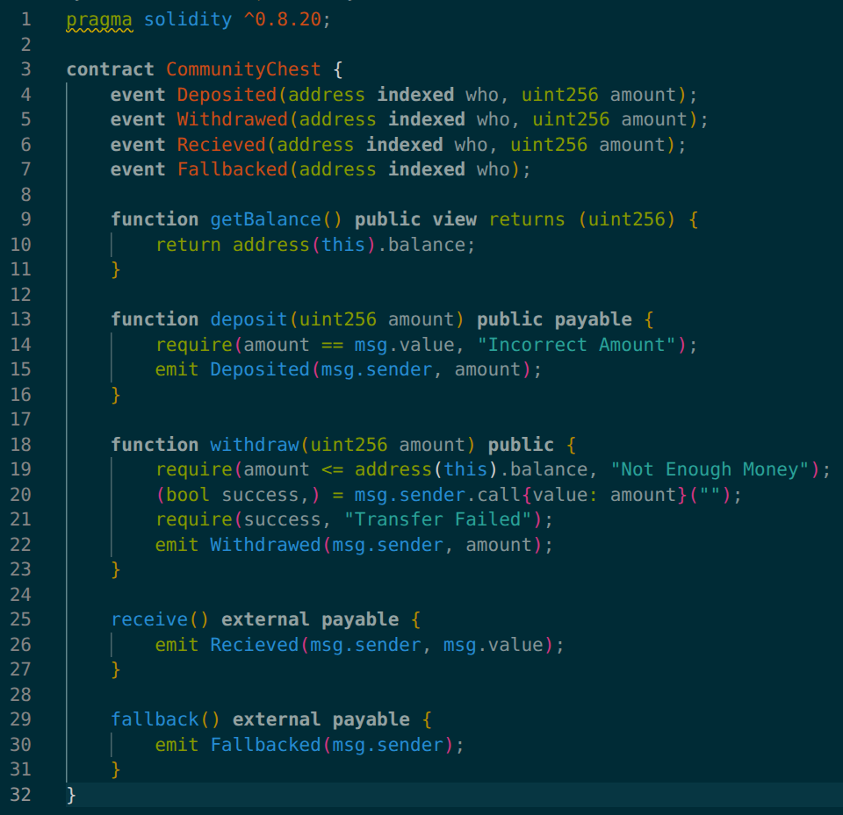
Community Chest v9

Slide 58
Owner
Commonly the idea of an 'owner' is used
This means often during construction, the owner's address will be supplied, and some functions will only work if the sender's address is the same as the owner's

Slide 59
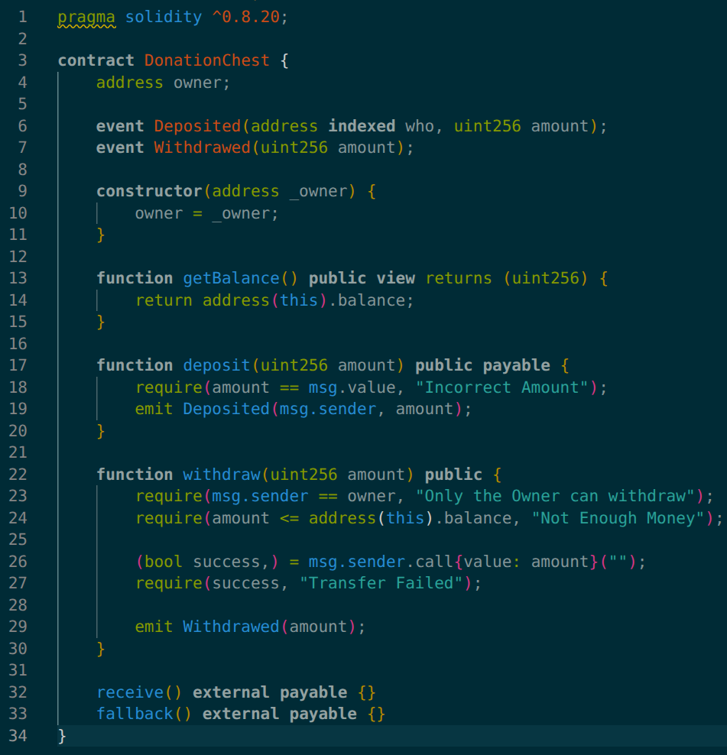
Donation Chest

Slide 60
Break

Slide 61
mapping
Another type in solidity is the 'mapping'
This is a HashMap or for Pythonistas a 'dictionary'
It makes 'key' -> 'value' pairs
Syntax to create:
mapping(<KeyType> => <ValueType>)
To get the value the syntax is:
<mapping_var>[<key>]
The default value for an unrecognised key is '0'
The keys can only be simple types (no mapping/arrays/custom types)

Slide 62
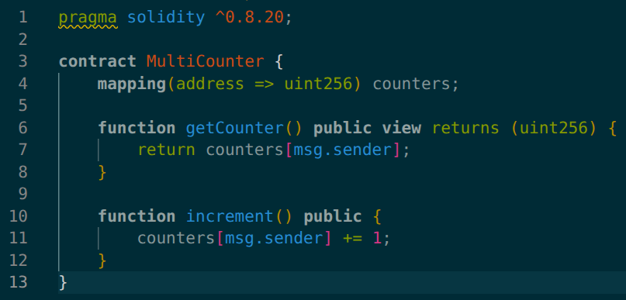
MultiCounter

Slide 63
fixed-size array and dynamic array
Solidity has both a fixed-size array, where the size is defined at initialisation, and dynamic-size arrays where elements can keep being added
The syntax is:
<Type>[<Length>]
For dynamic-size arrays, the length is excluded
An array of 5 dynamic arrays of uint256s would be 'uint256[][5]'
The arrays have '.push(x)', '.pop()', and '.length'
A 'string' counts as a 'fixed-size array' and 'bytes' counts as a 'dynamic array'

Slide 64
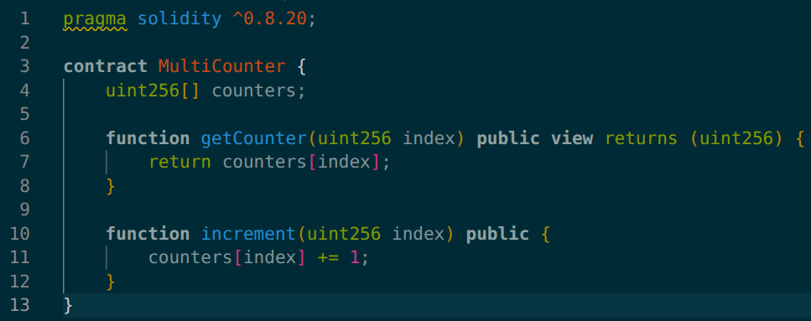
MultiCounter v2.0

Slide 65
Variable Visibility
public – creates a getter function automatically, that is an 'external view', for arrays/mapping, the arguments specify the index/key
private – the variable is not inherited
internal – no real use, just for other programmers to know, like in python

Slide 66
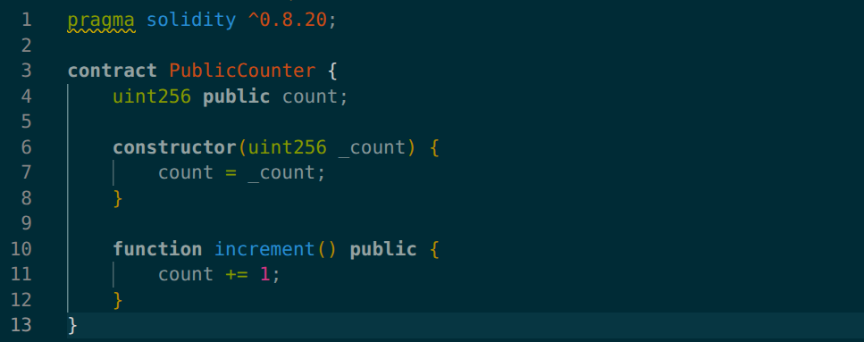
Public Counter

Slide 67
Variable Modifiers
memory - pass variable by value and copy into memory until the end of the function
constant – the value is constant, and set at compile time (same between deployments)
immutable – the value is constant, and set at construction time (might be different between deployments)

Slide 68
--gas-limit
For transactions sent, they normally use the smallest gas amount possible by sending a query to estimate the amount of gas that will be used, then sending a bit more then that
In case this can't happen, cast supports setting the gas limit yourself with --gas-limit <value>

Slide 69
Pico CTF Warning
For the PicoCTF challenges, normally the entire blockchain can be read, and so the flag can just be read off the blockchain
To stop this, they removed the ability to read the blockchain and therefore make and cast call requests, or to estimate gas
So, you will need to set the gas limit yourselves

Slide 70
Access Control
PicoCTF 2026

Slide 71
Custom Modifiers
Instead of the same code being repeated at the top/bottom of multiple functions, just like with decorators in python, custom modifiers can be made
The modifiers on a function run left to right

Slide 72
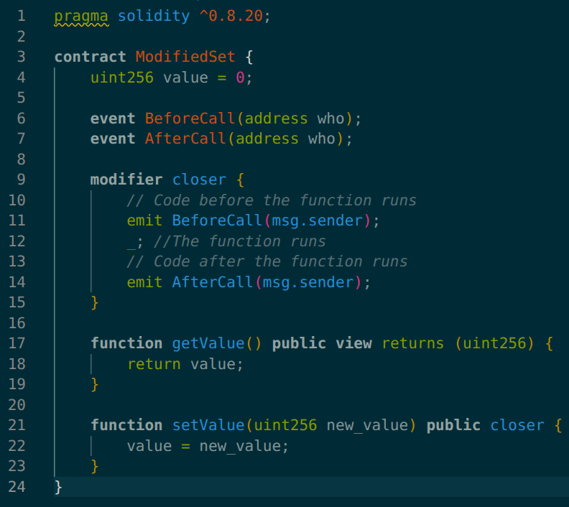
Modified Set

Slide 73
checked vs unchecked
Since solidity version 0.8.0 and after, integer overflows/underflows cause the transaction to fail except when done by bitwise operators
This can be gotten around by placing the math in an unchecked block
unchecked { uint8 a = uint8(255) + uint8(1) }

Slide 74
IntOverflowBank
PicoCTF 2026

Slide 75
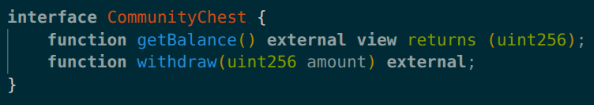
interface
An interface is a way to tell programs how it can interact with other contracts, without implementing the other contracts themselves
It is like defining an API for the other contracts

Slide 76
call functions of an interface
To use a contract after it is defined, an address can be mapped to an interface so the contract behind the address can be interacted with
This is done by '<InterfaceName>(<ADDR>)', then the functions are called as methods of the interface object

Slide 77
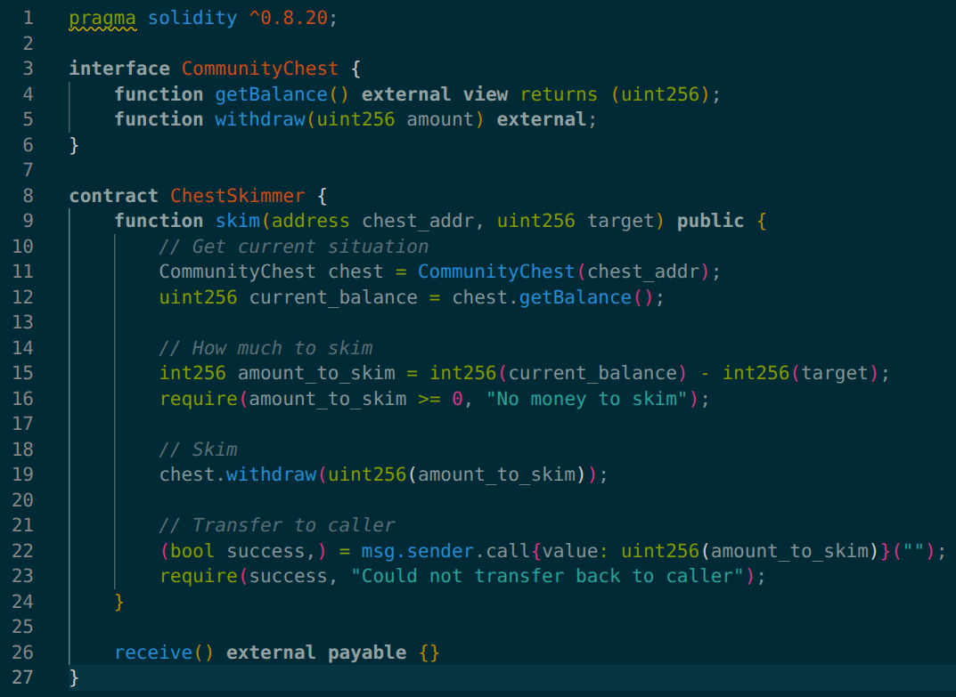
Donation chest Skimmer

Slide 78
Chains of Power
Australian Cyber Games 2025

Slide 79
Reentrancy
When one contract calls another contract, the first contracts execution is put on hold until the second contract replies that its side of the transaction was successful
This can be exploited as the contract called can recall functions in the original contract to bypass checks
E.g. if at an ATM you selected to withdraw $100 dollars, and the program checked you had $100, but would only minus it from your account when you clicked 'Confirm' but before you did, on the same ATM you started another request to withdraw $100 and you still the same $100 from before, it would offer then money, then you can click 'Confirm' on both and get $200 even if your account only had $100

Slide 80
Check-Effects-Interactions Pattern
The Reentrancy problem comes from if your contract works in the order:
Check for Validity
Do the transaction/Interactions
Change the values/Make the Effects
So, to stop it the order needs to change to:
Check for Validity
Make the Effects/change the values
Do the Interactions/Transaction

Slide 81
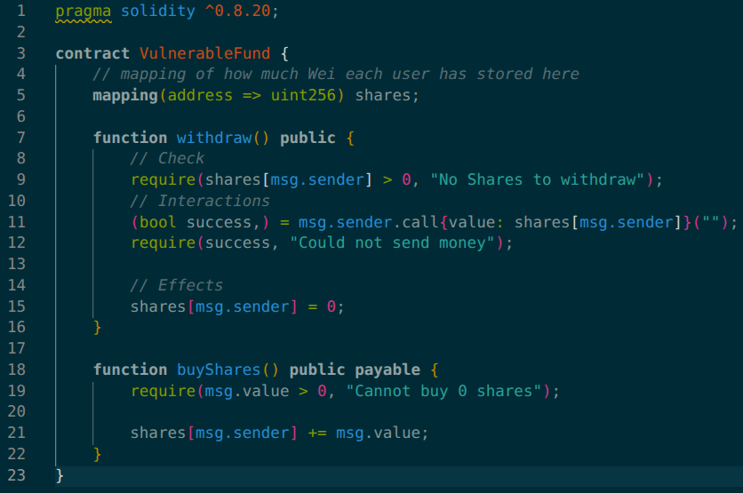
Vulnerable Fund

Slide 82
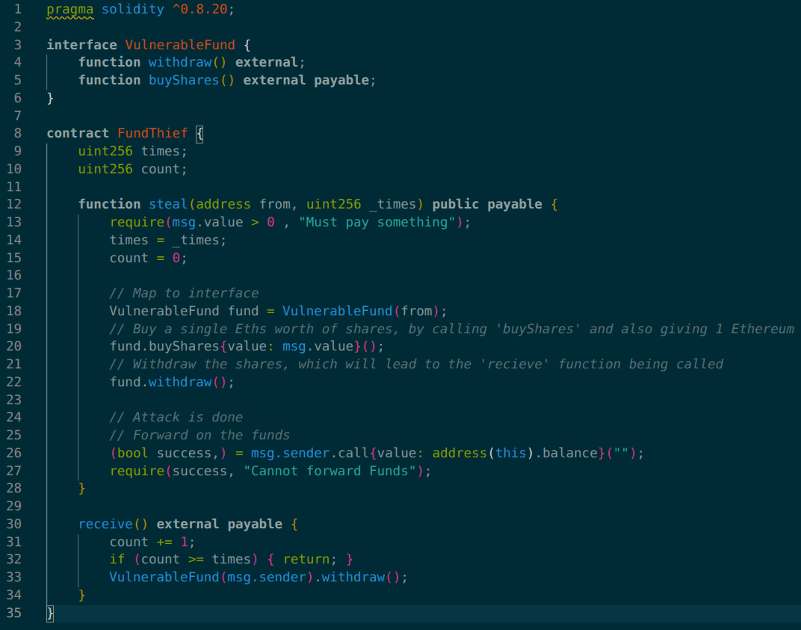
Fund Thief

Slide 83
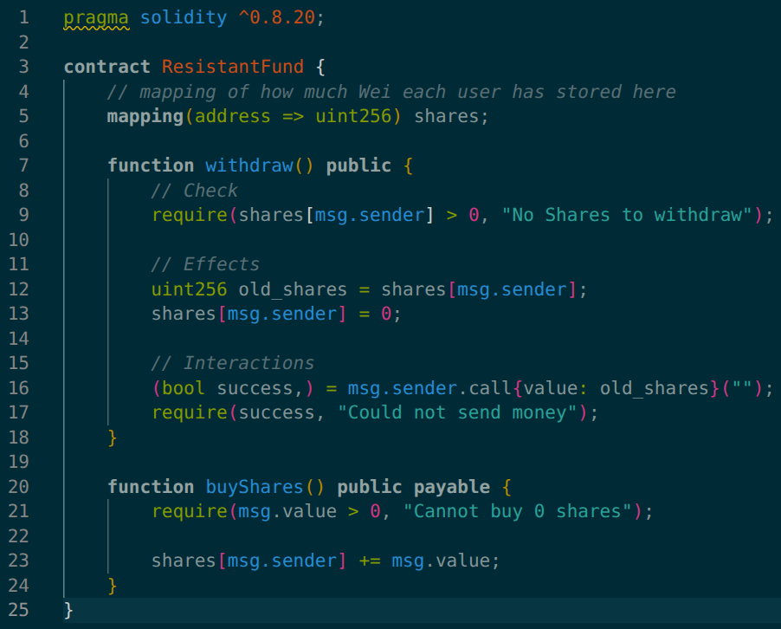
Resistant Fund

Slide 84
Reentrance
PicoCTF 2026

Slide 85
Smart Contract Storage
All persistent value in a smart contract are stored in the storage, which is on the blockchain and therefore globally readable
Even if they are 'private'
If you remember, the storage is a uint256 long array of 'slots' of size 32 bytes
Each slot can be read arbitrarily, by default they contain '0'

Slide 86
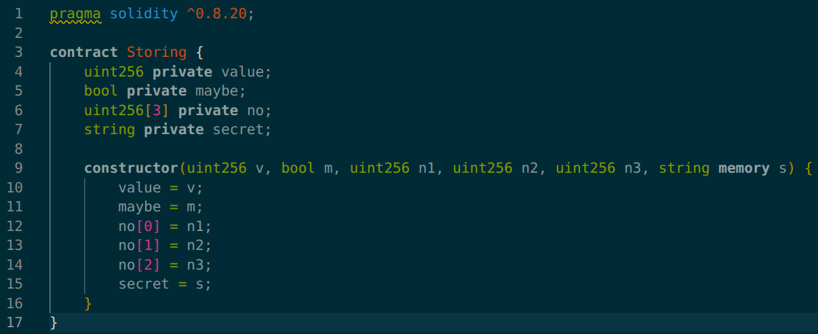
Variables -> Slots
The slots for storage are assigned, in the order the variables are read
So 'value' is slot '0'
'maybe' is slot '1'
'no' as an array of size three is slots '2', '3', and '4'
'secret' stores its length in slot '6', then each character are stored in the slots starting from the hash of '6'

Slide 87
cast storage
The storage can be read using 'foundry' with:
cast storage <ADDR> <Slot_Num> --rpc-url <URL>

Slide 88
Verifying Smart Contracts
When looking at a smart contract, all you get is an address and the trust that whatever code someone gave you is indeed the code behind that address
This trust is not needed, as the compiled code can be attained from the blockchain
Then by compiling the supposed code, with the same build instructions & compiler version, the same compiled code should be outputed

Slide 89
cast code
foundry lets you get the compiled code with 'cast code'
The syntax is:
cast code <ADDR> --rpc-url <URL>

Slide 90
Online Decompilers
This compiled code can then be disassembled/decompiled using an online disassembler/decompiler to see what has changed, or reverse engineer a non-open-source smart contract

Slide 91
The End

Slide 92
Learning More
If you want to learn more, I suggest either reading the solidity docs: https://docs.soliditylang.org/en/v0.8.35/
This guy's abandoned 8-year-old blog, which while it does contain some deprecated stuff, is very good at introducing you to concepts: https://programtheblockchain.com/
Try some levels of The Ethernaught, which is a small blockchain CTF training thing that assumes you have some knowledge: https://ethernaut.openzeppelin.com/

